Slide 1
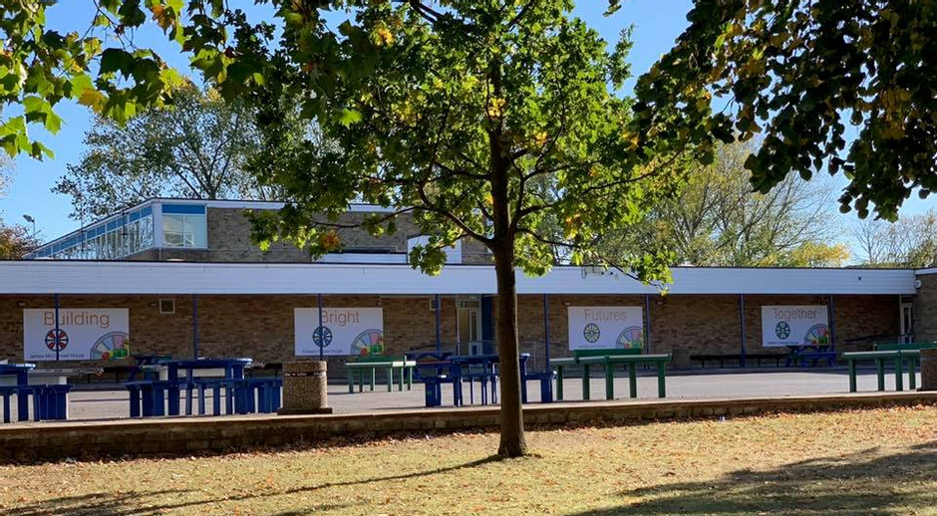


Examples of diversity and inclusion at The Radcliffe School MK

Slide 2

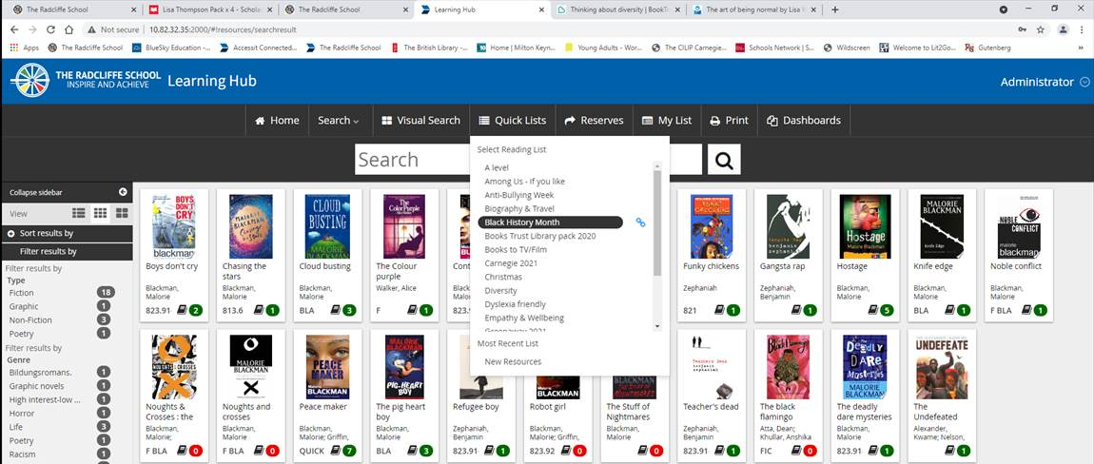
Librarian and reading intervention programme
Young adult fiction is more diverse with lots of different authors and stories.
Library records include more information about each book including tags like BAME, LGBT and diversity.
Displays and book lists are used to promote the resources relevant during celebration months like LGBT History month etc.
The librarian also join with other depts when they celebrate something and let them know which resources are available to support the events. Examples slide shows for the TV screens round the building and sent to tutors.
Reading slides used during tutorial to promote reading for pleasure to students include a broad range across the globe.
There are a large range of dyslexia friendly titles that are easily identifiable like graphic novels, manga, magazines and picture books. The librarian also look for the interests of SEND students so that she can help them choose Fiction and Non-fiction they will enjoy.

Slide 3

Music and Media
Media studies
Issues with diversity and equal representation in the media industry are actively discussed. Open conversations about the effects on the audience are discussed in classes.
15 different historical and modern media texts are studied in relation to diversity, racism, equal rights and feminism.
Practical NEA GCSE and A Level work (such as making film and magazine advertising) encourages students to positively represent minority groups or underrepresented groups such as religion, gender, race, age, size, sexuality or even disability.
Music
The music curriculum includes a wide range of music history and world music study such as pop, blues, classical, film, Indian, West African and Caribbean.
Blues music is studied by year 8s during Black history month.
Music from composers from a range of backgrounds is studied.

Slide 4

English
Areas of the curriculum which you have made more diverse (e.g. through de-colonialisation)
Teaching of poems from different cultures in Y9
Reading Friday stories from around the world in Y7 and Y8
Y8 study of Of Mice and Men
Y8 study of exploitation in 19th Century entertainment
Non fiction resources such THISDAY articles( include Black History Month, resources Women’s History, Month on topics different world religions and World Book Day resources
Library lesson resources cover issues like BAME, LGBT and diversity
Resources to teach about diversity and inclusion from a specific curriculum area
The Day articles
Schemes of Work with Youtube links – i.e. treatment of civilians during Iraq War for Y10 poetry
KS 4/KS 5 resources cover topics on diversity and inclusion- ethnic minorities/ LGBTQ+, awareness of different disabilities and how to support them.
Events or activities linked to the calendar year e.g. LGBTQ history month
Cheltenham Festival of Literature
Changes to pedagogy to ensure appropriate inclusion for children with SEND
Curriculum Map changes to pedagogy to ensure appropriate inclusion for children with SEND
Follow SEND strategies within lessons
Other resources used to ensure inclusion of all students-Visual aids to support understanding of theatre
Vocabulary bank to support oracy and developing responses.
Questioning to ensure misconceptions are rectified
Video support to aid the identification and analysis of structure, content, characters and language
Large print extracts
Extracts edited to provide support
Coloured overlays
Initiatives to improve the attainment and/or progress for children from diverse backgrounds
Mixed ability setting
Teaching of cultural capital through archetypal texts and character studies
Actions to increase inclusive behaviours and attitudes amounts the pupil
Achievement Points
De-escalation strategies
English Report as supportive strategy

Slide 5

Humanities
Areas of the curriculum which you have made more diverse (e.g. through de-colonialisation).
Added more Black History into the KS3 course Black History Month resources, Women’s History Month
RE – added more on different world religions Geography- added more case studies with culture resources to teach about diversity and inclusion from a specific curriculum area.
Adapted resources to be more inclusive In tutor time tutors will covering – a person from ethnic minorities/ LGBTQ+ (who they are, what they did/ do, why they are important).
Events or activities linked to the calendar year e.g. LGBTQ history month, Black History Month, Fairtrade fortnight
Changes to pedagogy to ensure appropriate inclusion for children with SEND
Follow SEND strategies within lessons
Actions to increase inclusive behaviours and attitudes amounts the pupil. Praise/ rewards/ postcards/ attainment

